Slide 1

Recent labour market trends in the Visegrad Group
26. 02. 2014. Hotel Novotel Danube, Budapest
Györgyi Ignits Deputy Head of Department Research and Analyses, National Employment Office, Hungary

Slide 2
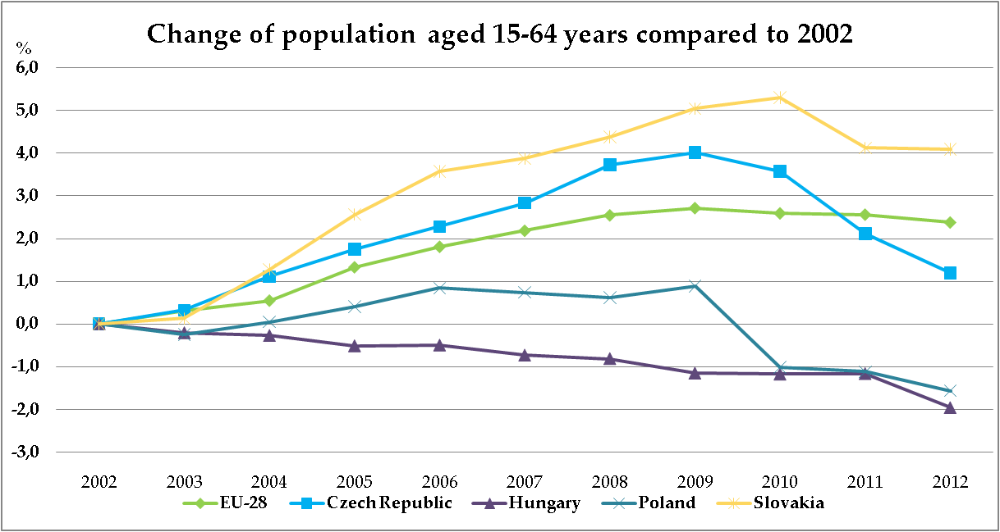

Recent demographic trends in the European Union and in the Visegrad Group 1.
Source: Eurostat
Notes:
Lets start with the fact that demographic trends show a decresing number of the working age population in the last three years that means that the bases of the labour supply is narrowing in each country. Due to ageing of the population we can see a break in the trend in PL, CZ, SK during the recent years.
The most deterioiating demographic trends can be observed in Hungary: continously decreasing trend.

Slide 3
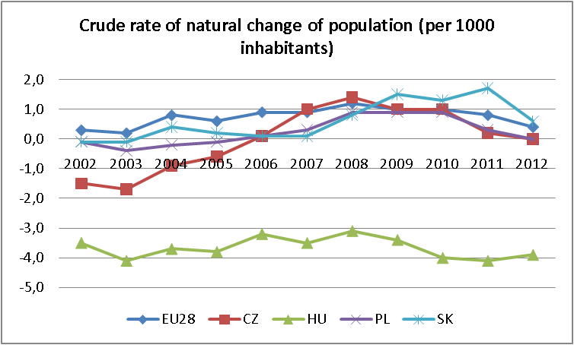
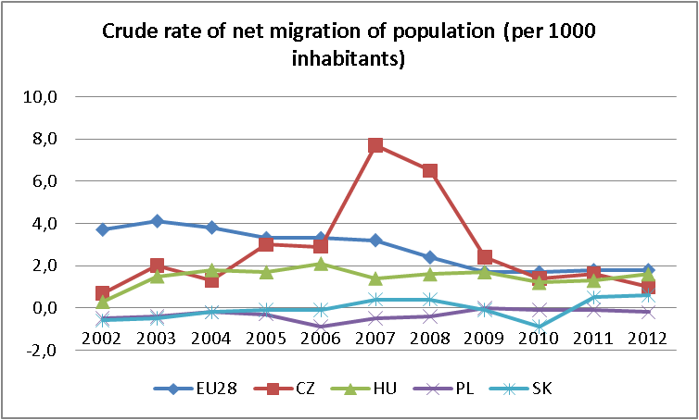
Recent demographic trends in the European Union and in the Visegrad Group 2.
v
Source: Eurostat
Notes:
In recent ten year the natural loss of poulation in Hungary was partly (about one-thirdly) cunterbalanced by migration gain,
Hungary is traditionally a relatively low migration country. Over recent years emigraton has sharply increased- while remaining lower than in some other eastern European countries- reflecting weaker economic prospects and the gradual opening of EU labour markets to Hungaian citizens. The main destinations are: Germany, Austria, UK.
Among the visegrad group the labour market of Poland is mostly affected by the migration as this country has negtive migration rate in recent years, but thee slovak, while the czech republic could gain many immigrants in the late 2000.
Besides demographic changes one further trend is also remarkable:
Change in age-distribution of the active population has been shifted. between 2002 and 2012 (2002=100) . Due to the trend that youth are entering into the labour market in a later age while old age groups remain active to an older and older age of their. If we look at deeper in hungarion figures , between the two last census the age group over 55 year in the economically active population has benn doubled in Hungary,but there was significant increase in each countries also in the VG.
15-24 years 55-64 years
European Union (28 countries) 89% 153%
Czech Republic 68% 155%
Hungary 67% 188%
Poland 69% 221%
Slovakia 58% 276%

Slide 4
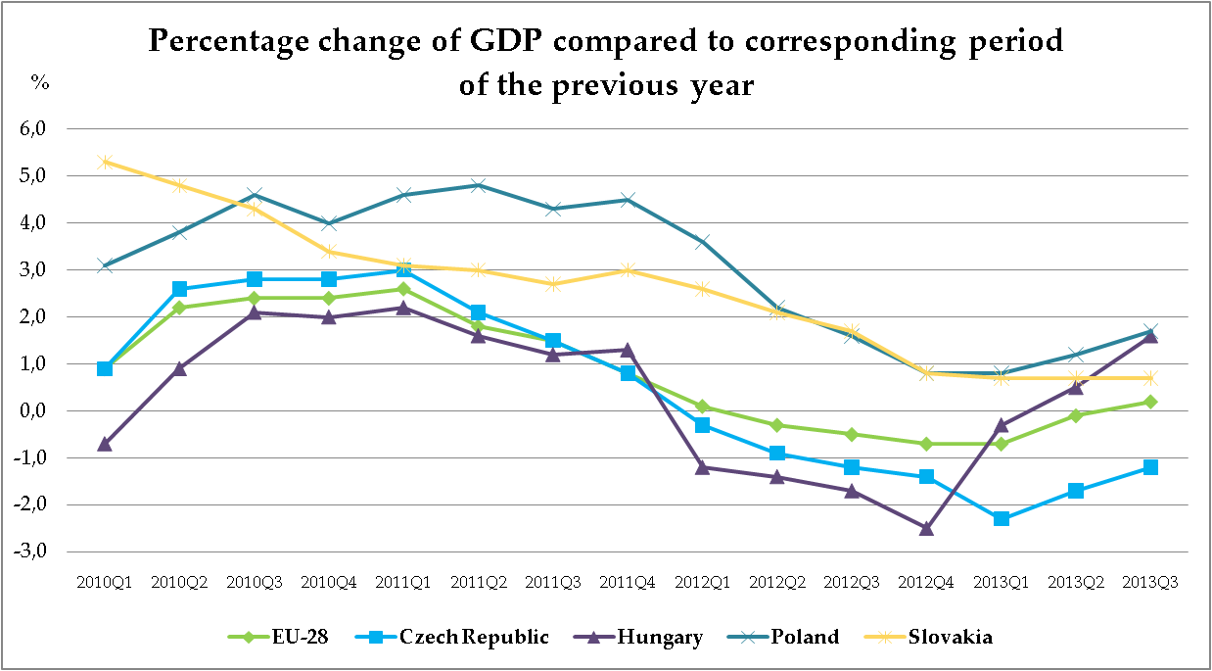
Macroeconomic environment
Source: Eurostat
Notes:
The first signs of recovery in ecnomic activity appeared and strenghtened in the EU region throughou 2013. The euro area emerged from recession during te second quarter of 2013 led by faster than expected growth in Germany thanks to its strong export sector. (v4 countris are in strong connecton to the german economy). There is an increasing GDP growth during 2013 in HU and PL, while in CZ the fall of output has been becoming slower. Meanwhile figures in Hungary has apperaed regarding to Q4 2013 and the rowth rate has been becoming faster:2,7% comparing….
The growth rate in the Czech Republic has been gradually deteriorating in 2011-2013 , the ecomony even declined from early 2012 and still in 2013 also. In Poland the least open economy in the region therfore the least exposed to fluctuations in foreign demand, domestic demand is able to positively contribute to the growth whics is also due to a lower level of hosehod indebtness. Therefore Poland is the most dynamic country in the region, however the growth rate lags behind its pre-crisis level. Slovakia follows up Poland but its growing rate is declinng.
Hungary: the crises hit the exporting sector the hardest but as external demand picked up, this sector ‘s recovery launched first.The growth rate was the lowest in hungary in the region in the recent 3 years. With high dept level, the consumption and investment of households dcelined. Positive trend-change can be seen in 2013, the economy started to increase in the 4. qurter it was 2,7% compared to previuus year. This growth is led by the growing export he growing output in 3 activity braches of the economy: construction, the industrial sector (expecially car industry) and by agriculture.
However there is a recovery in economic activty but not in jobs. Many counties are pursuing fiscal consolidation which complicates the achivement both employment and fiscal targets.
IlO conclusion: the recovery in output is not strong enough to compensate for losses during he recession vene in those countries where the expansion was strong. To sum up the number of employed has reached its pre crises volume in Hungary and Poland, Czech Republic is sagnating, Slovaika is lagging benid. (2007 3. negyedéve és 2013 3. negyedéve között).

Slide 5
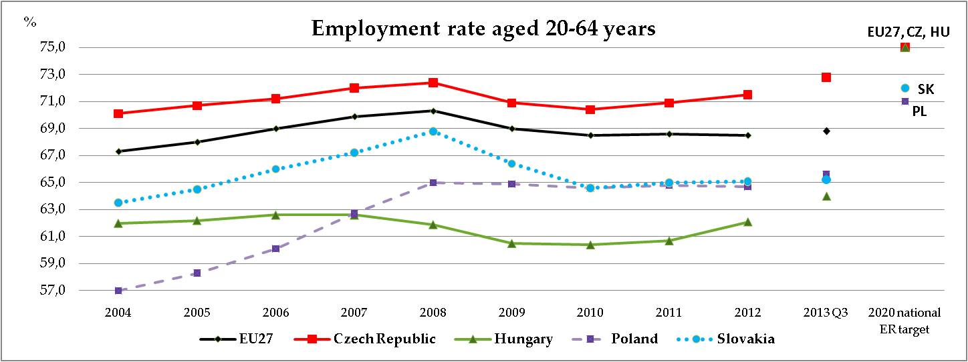
Main employment trends in the European Union and in the Visegrad Group
Source: Eurostat
Notes:
In the last three years emloyment rate was slightly increasing in CZ, SK- sharp decrease during the crises and since that time a stagnating trend can be observed. and PL stagnating since 2008, before the crises a very sharp improving trend from a very low level of employment in the early 2000s. , HU: increasing trend, reached its pre-crises level. There is a closing up trend (felzárkózó ) to the other countries and to EU avarege in Hungary in recent years. Expecially in 2013. In q3 2013 Hungary had the 3rd largest employment growth comapred to previuos year among the countries of the EU.
But the level of employment is the lowest in Hungary, that means by about 5 percentage point lower employment rate than EU average. But employment growth rate changed very heterogeounosly in recent years (eu averag covers vey hetergogean employment rates) this is accompanied by a medium sized level of unemployment. Taht means a relatively low level of activity besides 20-64 population: 30% are inactive the highest activity rate has got CZ almost 80%. Accompanied by a relative low level of unemployment. While SK second highest activity rate is accompanied by a relative high unemployment. I will later go deeper in uenmployment figures but lets stay for a littlemoment by this graph.
The graph contains national employment rate targets from National Reform Programme 2011, which is 75% for Eu27, Hu and Cz but lower in Sk (72%) and PL (71%) we can see which country has to make the biggest step to reach its national employment goal.
well.

Slide 6
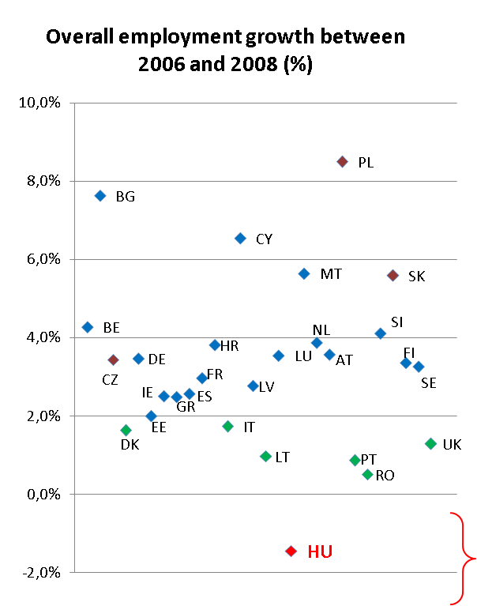
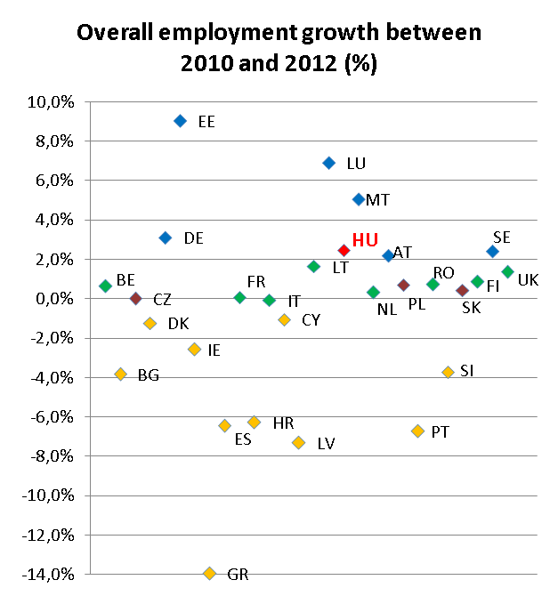








Source: Eurostat
Notes:
The crises reached hungary with an decreasing emploment (the employment growh was negatíive) while Poland had got the strongest growing rate among memberstates. After 2010 HU is among the growing coutries between 2010 and 2012 (and since that we are above pre-crises level) and a divergence can be observed among the european union memberstates.

Slide 7
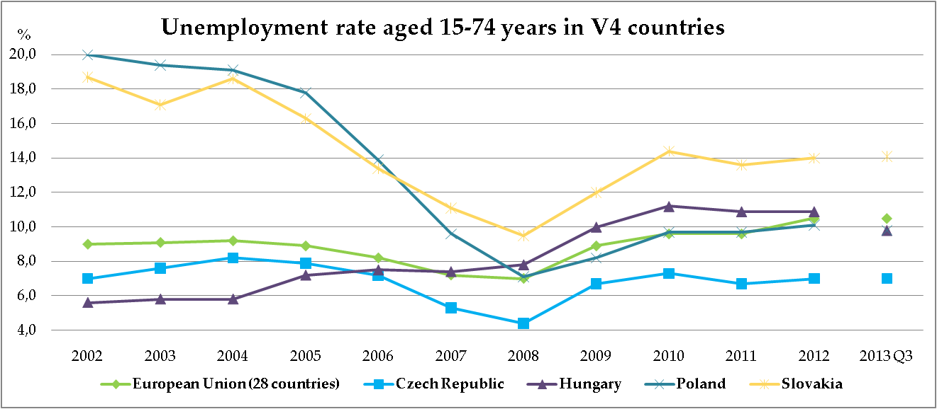
Recent unemployment trend in the European Union and in the Visegrad Group
Source: Eurostat
Notes:
Each V4 countries rate are above the rate in 2008. The sharpest increase ccpuld be observed by SK, but in each country unemployment figures continue to rise in many countries even in 2012 asn 2013. and particulary among young jobseekers.
I made a summing up. 2007 Q3 in the 4 visegrader coutries there were 2million400.000 unemployed in 2013 q3 this number is higer by 20 %, 2million900.000 persons.
The paticipation rate has grown faster than employment- labour supply is increasing and is reached its hihest level since the transition. This together with the weak economic activity uring the crises resulted that hungarian unemployment rate was the lowest in the early 2000s but it is now the second largest among V4 countries
HU the increasing employment is partly due to central measures renforcing the suplly of economically active population:positive labour supply shock: tightened the condition of retirement,expecially restricting early retirement, raising pension age, stricter conditions to disability pensions, social type supports are available only in case of certain amount of days in employment. Other resons: active measurin, including public work programmes, but other supported work pomgrames for specialized target groups and reducing social contribution of the wages by caertin target groups (Job Protection Act).

Slide 8
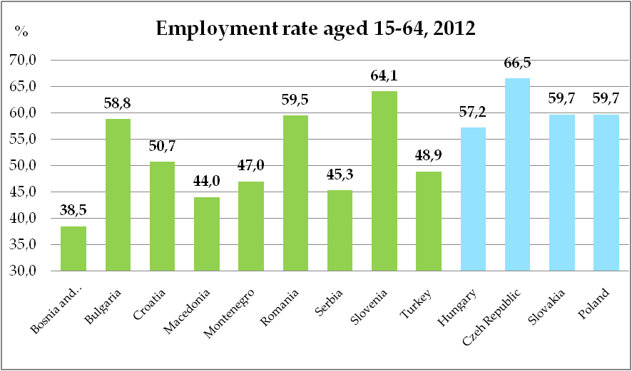
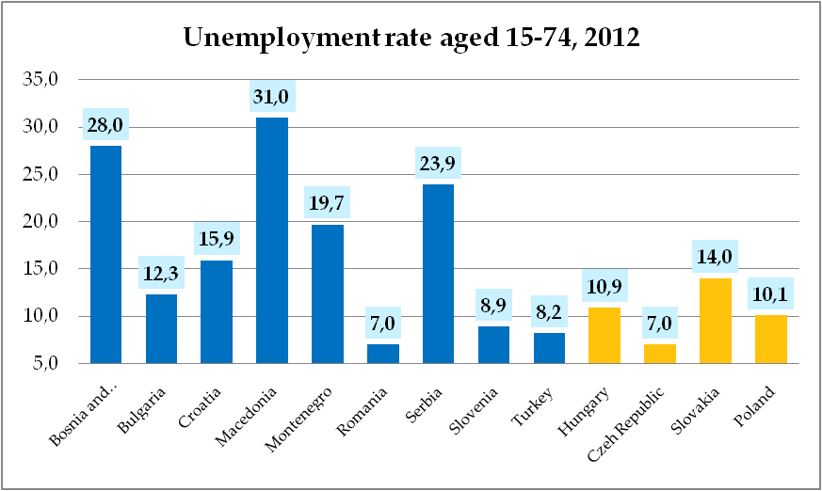
Brief outlook: main labour market figures in CPESSEC
Sorce: Eurostat, CPESSEC, Statistical Office of Montenegro

Slide 9
Employment charasteristics 1.
Source: Eurostat
Notes:
If we look at the reason what stand behind the lagging figures of employment in the 4 visegrader countries, we can see that lo employment is concentrated in several labour market groups. compared to EU average, on the one hand the older population participate at lower level in the wotkforce: PL and HU. There was a signiificant improving in recent years but still very low. On the other hand significant lagging can be observed by low educated and women in childbearing age na d b youth also. Best working ages: the same level as in the EU.
Speciality is in the Visegrad Group the huge differences in the employment rate among the groups at different educational level.
To sum up Czech level of emplyment exceeds eU average, in the youth age group and by low-educated there is a uniform legging behind in the VG.
It is worth to remark, that by women there is a minor difference between the Cz employment rate and those of HU, PL, SK while bymen the difference is larger.

Slide 10
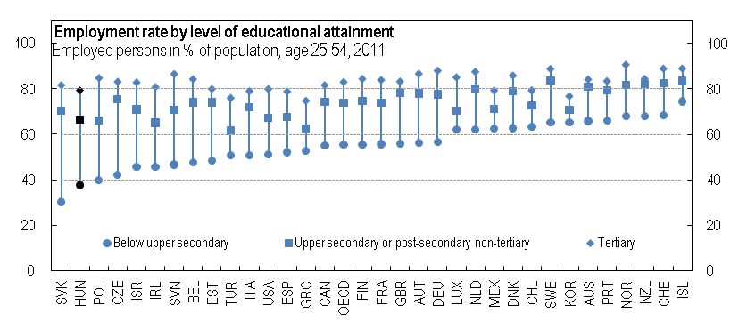
.
Employment charasteristics 2.
Source: OECD
Notes:
Common feature: Low skilled: The main mismatch is a large structural excess of low skilled labour supply resulting in a very low employment rate among this group (while high skilled labour is in somewhat tight supply- bottlenecks - in certain fields). Less than 40% of people with at most lower-secondary education are in employment. In some regions oversupply of low skilled workers are much more charasteristic. if wee rank EU countries from the lowest level of employment by below upper secondary group, the V4 countries are the first four countries
This reflects both a lack of skills and employability as some wokers have been out of employment for a long time and the relatively high cost of low-skilled labour.
Low skilled: magyarok-chehek-lengyelek azonos, szlovákok nagyon lemaradva

Slide 11
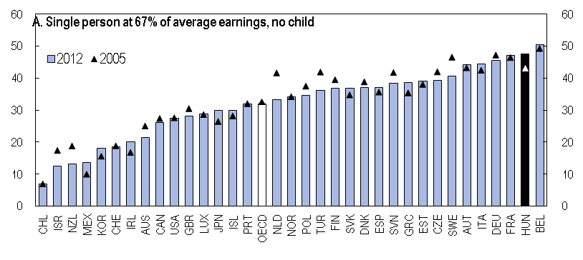
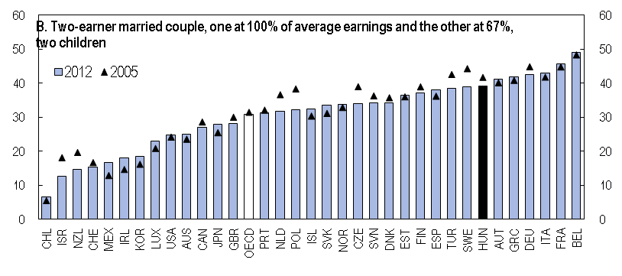
Average tax wedge on low to average wages in OECD countries
Source: OECD
Notes:
The main reason is a high tax wedge on low salaries. This reflects high social security contribution and a flat income tax rate. In 2013 Job Protection Action Plan reduced the tax wedge for certain groups. This was a right step but remains substantialy higher than the OECD average.

Slide 12
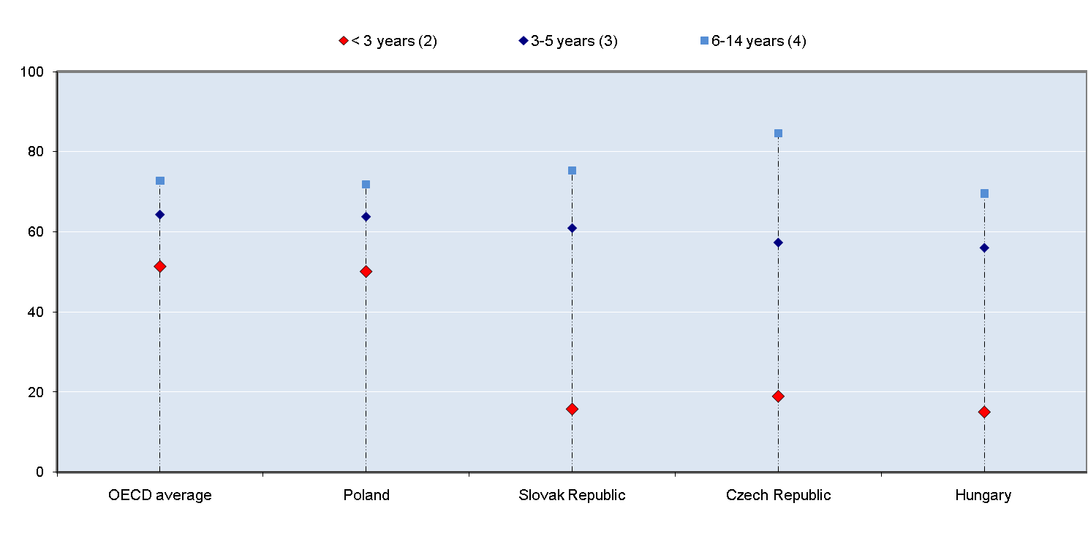
Maternal employment rates by age of youngest child, 2009
Source: OECD
Notes:
A maiin structural feature of employment level for v4 is low level of maternal employmnet: this means that employment impact of parenthood on women is high. Maternity allowances allows a relative long tie to be at hone for mothers with her child/chldren. IF we compare empoyment rate of hungarian women aged 25-34 it is by 15% lower than those who are in thesir 40s. Very large diffences
In hungry it is culturally deeply embedded to rise uo at home a 2-3 years old child, but in some sases mothers gong back to work is accepted F. E. part-time employment, flexible employment.

Slide 13
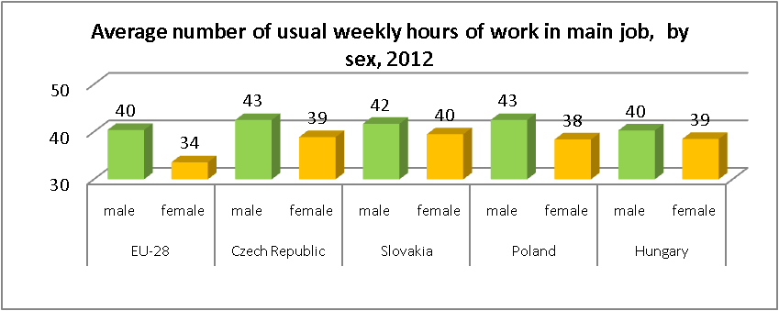
Role of part-time employment
Part-time employment as a percentage of the total employment, 2013Q3
 | 15-64 years |  |  | 15-24 years | 55- 64 years
 | Total | Males | Females
EU28 | 19,2 | 8,7 | 31,7 | 30,6 | 22,2
CZ | 5,8 | 2,5 | 10,0 | 11,6 | 8,1
HU | 6,3 | 4,0 | 9,0 | 8,4 | 11,6
PL | 6,9 | 4,3 | 10,2 | 15,9 | 12,0
SK | 4,3 | 3,1 | 5,9 | 8,8 | 5,5
Part-time underemploment: involuntary part-time employment as percentage of the total part-time employment (aged 15-64 years), 2012 (%)
Total | EU-28 | 27,6
 | Czech Republic | 20,0
 | Hungary | 41,1
 | Poland | 27,5
 | Slovakia | 32,1
Male | EU-28 | 38,9
 | Czech Republic | 14,6
 | Hungary | 45,2
 | Poland | 26,9
 | Slovakia | 35,4
Female | EU-28 | 24,4
 | Czech Republic | 22,0
 | Hungary | 38,9
 | Poland | 27,9
 | Slovakia | 30,0
Source: Eurostat
Notes:
But female part time employment is quite rare in Hungary and in VG and the lowest is in SK. Low level of employment: an other structural reason can be mentioned the low level of part time employment in VG.
Számok. To sum up we can say that less males and females do work in VG countries but they work much.
Crises had a negative impact ont he quality of employment in most countries as the incidence of involuntary temporary and part time employment. Although in HU working in part-time empoyment has recently become more widespread, Hungarian employers choose this solution less frequently in comparison with the EU Expecially in Hungary can be observed that : the growth rate of part tiime employees has benn much higher in Hugary in recent years, but parallell with this trend involuntary part time employment has been grown up: 41% much higher by men (45%).

Slide 14
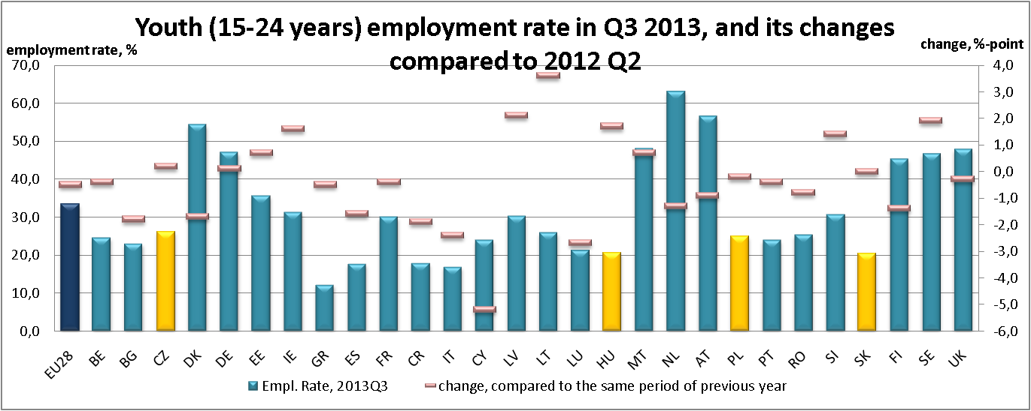
Labour market situation of youth 1.
Source: Eurostat
Notes:
For the last topic:
The youth were among the losers in the labour market situation emerged in the aftermath of the crisis. From a labour market aspect, young people are far more vulnerable and their situation is rather uncertain as they have multiple disadvantages compared to the 25-54-year-old population in best working age. Such disadvantages may include the lack of work experience; lower than necessary qualifications; or a role played in generating income for the family. Youth: young adults re the first to face job losses in crisis times due to their lower seniority and the job protection afforded to older workers.
As a consequence of low and declining labour force participation, the youth employment rate also remains low in international comparison and lags far below not only the EU average but even below the same indicator measured in the 12 Member States joined to the EU together with Hungary. In recent years, according to domestic indicators, Hungary was already one of the lowest-ranking countries among the EU27 Member States regarding youth employment: following a steady decline, the employment rate among 15-24-year-olds was 17.8% in Q2 2012, which was below the Community average significantly, by 15%.
But I would like to call the attention that these
discrepancies in youth employment rates between different European countries mostly reflect differences in educational systems. Differences are even more striking regarding the 15-19-year-old age group, as in countries applying a dual training system a high percentage of secondary school students work besides their studies. (E.g. the employment rate in this age group is 50% in Germany and the Netherlands, 40% in Austria, while less than 3% in Hungary.) This implies that young people in these countries are already much closer to the “real” labour market at an age as early as that.

Slide 15
Labour market situation of youth 2.
 | 2013Q3
 | unemployment rate (15-24 years) | unemployment ratio (15-24 years)
EU28 | 23.0 | 10,0%
Czech Republic | 19,6% | 6,4%
Hungary | 27,4% | 7,8%
Poland | 26,6% | 9,0%
Slovakia | 33,7% | 10,4%
 | 2012, NEET rates
 | 15-24 years | 25-29 years
EU28 | 13,1 | 20,6
Czech Republic | 8,9 | 19,6
Hungary | 14,7 | 26,0
Poland | 11,8 | 22,1
Slovakia | 13,8 | 27,1
Source: Eurostat
http://epp.eurostat.ec.europa.eu/cache/RSI/
Notes:
Labour market disadvantages don’t take country borders into consideration but reginal descrepancies are set up indepenndently of country borders but in a regional- manner crossing country borders.
High and persistent regional disparities --- creation of low tax zones
It is only a one-sided picture if we only look at the unemplyment rate of the youth.
WHY?
Unemployment ratio and NEET rates- are aldo very important because very low employment rate- this manily reflect of the educational system
The least painful way employers responded to economic difficulties was to stop or defer recruitment, which affected the youth to a greater degree. Furthermore, a greater percentage of them were afflicted by layoffs, since they had filled insecure jobs which employers found easier to cut. Thus, youth unemployment assumed increasing proportions and has by now eroded improving pre-crisis tendencies.
Leírni hogy mennyivel nőtt
youth unemployment showed a faster rate of deterioration.
. The reason is that the overwhelming part of this age group has not yet entered the labour market and so the number of those employed determining the denominator of the unemployment rate remains rather low.
Besides the unemployment rate, another “acknowledged” indicator of the labour market situation of young people is the share of the unemployed among the population. This indicator measures the percentage of unemployed people in a particular age group and thus does not depend on the number of economically active persons or of those employed who determine it in a greater extent. The analysis of this data among 15-24-year-olds shows a rate of 6.9% in Hungary (Q2 2012 figure), which is better than the EU average (9.4%). In other words, our unfavourable position regarding the rate of unemployment – compared to the EU average – is not that unfavourable when the number of unemployed is compared to the overall number of population. The underlying observation is that while 93.5% of the 15-19-year-olds was still in education, the number of students gradually decreased in the higher age groups , with barely over 10% of 25-29-year-olds present in the educational system in 2011.
NEET rate[1], which shows the proportion of young people neither in employment nor in education or training. Those “not in employment” include not only persons wishing to work but excluded from the labour market for some reason but also persons who do not want to work.
[1] NEET= Young people not in employment and not in any education and training. Based on the NEET rate, Hungary with a rate of 13.3% is ranked in the middle among the 27 Member States of the European Union, which is below the EU27 average by 0.4 percentage points. The same rate was below 7% in four of the 27 Member States (Denmark, the Netherlands, Austria and Luxemburg) and above 18% in five Member States (Ireland, Latvia, Bulgaria, Spain and Italy).

Slide 16
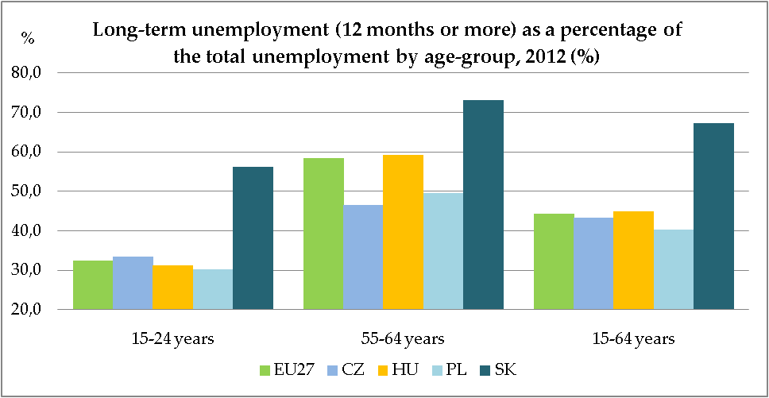
Long-term unemployment
Source: Eurostat
Notes:
Overall trend: unemployment is becoming more persistent: there is a countinous rise in average unemployment duration which indicates a lack of job creation. Visszautal: The share of older people in the workforce is rising + Weak recovery in job creation + growing average unemployment duration Consequance: getting jobseekers back to employment can become more difficult.

Slide 17
Key employment challanges
Low employment rate of low skilled (SK, PL, HU, CZ) and youth (SK, PL, HU)
High youth unemployment (SK, PL, HU)
In spite of recent improvements, low employment rate for older (PL, HU)
Oversized agricultural sector generating hidden unemployment in rural areas (PL)
High share of employees in temporary employment, low transation rate to permanent employment (PL)
Long term unemployment is significantly higher than EU average (SK)
Inactivity due to family responsibility significantly hihger than EU average, childcare is lower (SK, HU, CZ, PL)
High tax wedge (SK, HU-decreasing)
Participation in lifelong learning is below the EU average (SK, PL, HU)
Source: EC EMCO

Slide 18
Thank you for your attention!
ignitsgy@lab.hu
Notes:
In shorter term lower labour cost would foster demand for low-skilled labour, int he longer term: upgrading labour supply by raising educational outcomes and t improve scholl to work transition., more focus on life long learning.That is the reason why is it so much important to discuss and develop or prognses system acording to the changing nature of the economic needs. Unemployed to aquire those skills which can be benefit from the new jobs of eonomic recovrey. How can we measure sdemaand side how can we facilicitate the relebant uptraining of unemployed.

